Slide 1


NewOz
Steps toward a new syntax for the Oz programming language
Martin Vandenbussche
Promoter : Peter Van Roy
Academic year 2020-2021

Slide 2

Initial situation : a couple observations
Today, Oz’s syntax is a drawback to its growth outside of education
It is a barrier to many new users
In turn, the community is not very active
The documentation and software support is limited and not well maintained
However, it has huge potential in teaching, through its easy and complete semantics
The kernel language approach is useful to iteratively add concepts during the course
It has very good support for concurrent programming
Its functional dataflow paradigm is used increasingly in big data (MapReduce, …) -> very relevant in the industry !
Teaching programming through concepts is an approach that is very successful (see the courses of Prof. Henz at NUS, or Prof. Van Roy at UCLouvain)
Oz is one of the best languages to do this

Slide 3

What solution do we propose ?
Oz, in its current state, fulfills its role in an educational context
The syntax doesn’t pose real problems there
But it is an obstacle to its growth outside of that context
We aim to create a bridge towards the industrial languages and their communities
Through a new syntax, more aligned with modern, industry standards
While keeping Oz’s easy semantics and multi-paradigm capabilities
So as to not impact its educational value

Slide 4
Last year’s thesis of Jean-Pacifique Mbonyincungu
A new syntax for Oz, called “NewOz”
Inspired by Ozma (an extension of Scala adding Oz concurrency¹)
A careful review of Oz syntax elements
For each of them, a discussion on Scala’s approach and a proposed solution
The “Parser” : a NewOz to Oz translator written in Scala
Some limitations / problems :
Some syntax elements haven’t been addressed -> some inconsistencies in NewOz as a result
Also, the performance and behavior of the Parser is not great
Still, this was a huge first step and a very nice first result
1: Sébastien Doeraene. “Ozma: Extending Scala with Oz Concurrency”. Prom. Peter Van Roy. MA thesis. École Polytechnique de Louvain, UCLouvain, 2003. url: https://www.info.ucl.ac.be/~pvr/MemoireSebastienDoeraene.pdf.

Slide 5
Our starting objectives
What did we aim to contribute to the project ?
Review of existing concepts, sources of inpspiration, previous works
Improving on the new syntax, completing and refining it
Creating a full, performant compiler for the new syntax
Getting an external evaluation of the syntax from users
=> Our main focus this year

Slide 6

Review of existing concepts, sources of inspiration, previous works
Takeaways from this phase :
Designing a syntax is complex and takes time
A nice syntax by itself is not enough to be successful : community and/or big actor’s support are needed
The demand for multi-paradigm languages is there (Scala is functional & object-oriented, Rust is functional & concurrent/actor-model, …)
A modern language must support multiple paradigms to be useful
Ozma showed that the concepts of Oz can be ported into other languages in the form of conservative extensions

Slide 7


Improving on the new syntax, completing and refining it
Results from this phase :
A new version of the syntax : “NewOz 2021”
A tutorial and documentation around the syntax, with code examples etc., available on GitHub
A standard library built into the language, ported from Mozart

Slide 8

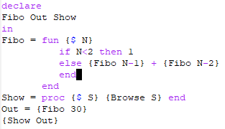
Fibonacci example (Oz)
A recursive function computing the Nth element in the Fibonacci sequence
This code showcases how functions and procedures are values in Oz, which can be stored in variables
This code makes use of the built-in function {Browse}

Slide 9
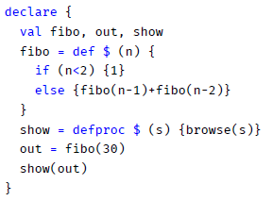
Fibonacci (NewOz)
Values declarations are aligned with Scala
C/Java-like conditional statements
Function/procedure calls are more in par with recent languages
This code makes use of the built-in function browse()

Slide 10
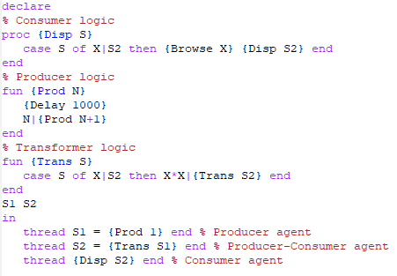
Pipeline example (Oz)
Thread-agents :
A consumer, displaying the stream
A transformer, making computations on the stream
A producer, generating the stream
All in a very compact syntax thanks to logic variables allowing data-driven computations

Slide 11
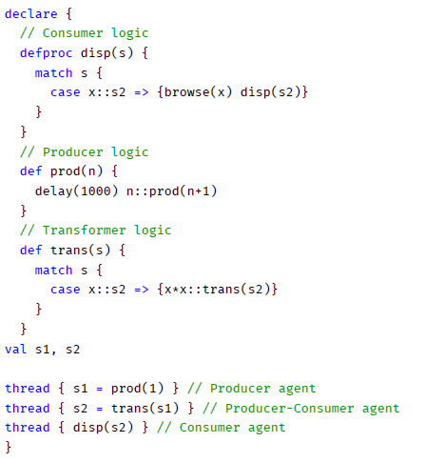
Pipeline (NewOz)
Same 3 thread-agents :
Pattern-matching is closer to Scala and Java’s approach
Showcases the use of curly braces for scoping
Val keyword declares constant values (= Oz variables)
All in the same amount of significant SLOC

Slide 12

Creating A Full, Performant Compiler For The New Syntax
Results from this phase :
A new compiler : nozc
Written in Java 16 using modern libraries and frameworks
Focus on portability and maintainability
Fully open-source with a permissive, BSD licence – available on GitHub
A powerful CLI, with among others the ability the print the generated AST
Able to translate NewOz code to the Oz equivalent, and then run ozc depending on the command-line arguments
Includes most of Mozart’s built-in library

Slide 13

Getting an external evaluation of the syntax from users
Our feedback methodology :
By reaching out to contributors on Twitter, Alumni mailing lists and other forums
Asking them to give their opinion on the GitHub repository
Providing them with documentation on how to use the syntax and its compiler
We got mitigated results :
Limited amount of participants
Mostly “surface-level” feedback (discussion on the choice of a specific keyword, etc.)
No real discussion on “philosophical” choices
The time in a (15-ECTS) thesis is limited : future reach-outs should happen over a longer period !

Slide 14
Getting an external evaluation of the syntax from users
Back to the drawing board :
Reinforces our idea that community is everything
Let’s not make the same mistakes Oz did !
New idea : why not start from an existing language ?
We take an existing syntax / platform
Create a conservative extension of it
Implementing Oz’s concepts on top of it

Slide 15
Getting an external evaluation of the syntax from users
Pros :
We have an easier time attracting existing users
We can address specific lacking points of the language
We may have impact on the future of the language (see Ozma)
We keep the educational value of the multi-paradigm approach
Cons :
We don’t rely on the independent Mozart platform anymore -> loss of “independence” : this is not “Oz” anymore
Choosing the right platform will be difficult – but the choice is not irreversible : why not create multiple extensions for multiple languages ?

Slide 16
Getting an external evaluation of the syntax from users
We provided arguments for a JavaScript extension
Its subset SICP is used by Prof. Martin Henz at NUS to teach programming, using a progressive multi-paradigm approach
Martin Henz was one of the creators of Oz, he created its object-oriented system
JS has problems, for which Oz provides a very good solution :
Lack of real concurrency in the engine
Temporal Dead Zone and unbound values
Tail recursion and call stack optimizations with logical variables
The idea would be to extend JavaScript with Oz concepts : could ease the creation of a community around the language (JS’ userbase is massive !)
This type of extensions has been done before (Ozma, FlowJava² (a Java extension with Oz declarative concurrency), …)
We would keep the multi-paradigm approach to teaching programming, but not necessarily with Oz
2: DREJHAMMAR, Frej, SCHULTE, Christian, BRAND, Per, et al. Flow Java: declarative concurrency for Java. In : International Conference on Logic Programming. Springer, Berlin, Heidelberg, 2003. p. 346-360.

Slide 17

The project is at a crossroad
Continuing to build upon NewOz
Transferring Oz’s concepts to other platform(s)
Bringing Oz to a potentially very large audience
But losing Oz’s specificity
Keeping the Mozart system
But with a more limited community
But how do we define a language’s identity ?

Slide 18
Results of this thesis
Advancements on NewOz, a new syntax for Oz, integrated in the Mozart system
A first compiler for NewOz
A more profound reflection on what makes Oz ~>
Another possible future for Oz, in the form of a conservative extension to Source / JavaScript
=> Big potential for future works, in collaboration between the NUS and UCLouvain

